Slide 1
19
Searching and
Sorting

Slide 2
With sobs and tears he sorted out Those of the largest size…
  Lewis Carroll
Attempt the end, and never stand to doubt;
Nothing’s so hard, but search will find it out.
  Robert Herrick
‘Tis in my memory lock’d, And you yourself shall keep the key of it.
  William Shakespeare
It is an immutable law in business that words are words, explanations are explanations, promises are promises — but only performance is reality
  Harold S. Green

Slide 3
OBJECTIVES
In this chapter you’ll learn:
To search for a given value in a vector using binary search.
To use Big O notation to express the efficiency of an algorithm and to compare the performance of algorithms.
To review the efficiency of the selection sort and insertion sort algorithms.
To sort a vector using the recursive merge sort algorithm.
To determine the efficiency of various searching and sorting algorithms.
To enumerate the searching and sorting algorithms discussed in this text.
To understand the nature of algorithms of constant, linear and quadratic runtime.

Slide 4
19.1 Introduction
19.2 Searching Algorithms
19.2.1 Efficiency of Linear Search
19.2.2 Binary Search
19.3 Sorting Algorithms
19.3.1 Efficiency of Selection Sort
19.3.2 Efficiency of Insertion Sort
19.3.3 Merge Sort (A Recursive Implementation)
19.4 Wrap-Up

Slide 5
19.1 Introduction
Searching data
  Determine whether a value (the search key) is present in the data
  Algorithms
    Linear search
      Simple
      Slow for large sets of data
    Binary search
      Fast, even for large sets of data
      More complex than linear search

Slide 6
19.1 Introduction (Cont.)
Sorting data
  Place data in order
    Typically ascending or descending
    Based on one or more sort keys
  Algorithms
    Insertion sort
    Selection sort
    Merge sort
      More efficient, but more complex

Slide 7
19.1 Introduction (Cont.)
Big O notation
  Estimates worst-case runtime for an algorithm
    How hard an algorithm must work to solve a problem

Slide 8
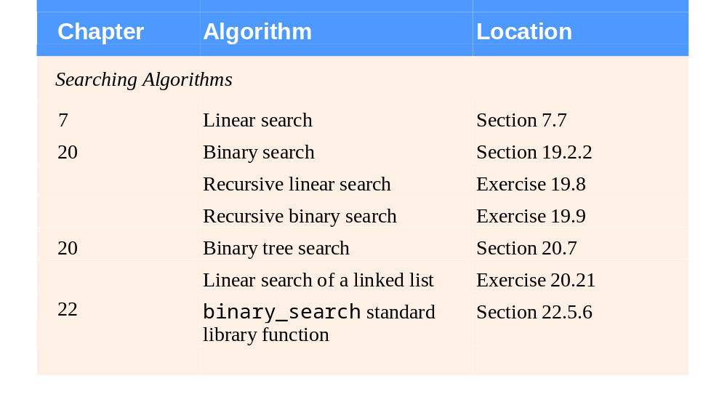
Fig. 19.1 | Searching and sorting algorithms in this text. (Part 1 of 2)

Slide 9
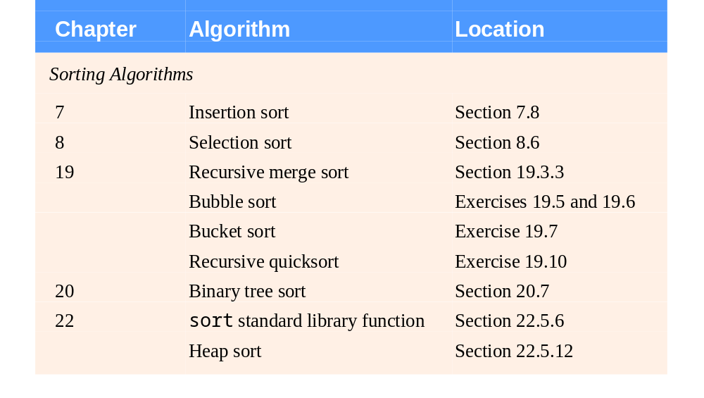
Fig. 19.1 | Searching and sorting algorithms in this text. (Part 2 of 2)

Slide 10
19.2 Searching Algorithms
Searching algorithms
  Find element that matches a given search key
  Major difference between search algorithms
    Amount of effort they require to complete search
      Particularly dependent on number of data elements
      Can be described with Big O notation

Slide 11
19.2.1 Efficiency of Linear Search
Big O notation
  Measures runtime growth of an algorithm relative to number of items processed
    Highlights dominant terms
    Ignores terms that become unimportant as n grows
    Ignores constant factors

Slide 12
19.2.1 Efficiency of Linear Search (Cont.)
Big O notation (Cont.)
  Constant runtime
    Number of operations performed by algorithm is constant
      Does not grow as number of items increases
    Represented in Big O notation as O(1)
      Pronounced “on the order of 1” or “order 1”
    Example
      Test if the first element of an n-element vector is equal to the second element
        Always takes one comparison, no matter how large the vector

Slide 13
19.2.1 Efficiency of Linear Search (Cont.)
Big O notation (Cont.)
  Linear runtime
    Number of operations performed by algorithm grows linearly with number of items
    Represented in Big O notation as O(n)
      Pronounced “on the order of n” or “order n”
    Example
      Test if the first element of an n-vector is equal to any other element
        Takes n - 1 comparisons
        n term dominates, -1 is ignored

Slide 14
19.2.1 Efficiency of Linear Search (Cont.)
Big O notation (Cont.)
  Quadratic runtime
    Number of operations performed by algorithm grows as the square of the number of items
    Represented in Big O notation as O(n²)
      Pronounced “on the order of n²” or “order n²”
    Example
      Test if any element of an n-vector is equal to any other element
        Takes n²/2 – n/2 comparisons
        n² term dominates, constant 1/2 is ignored, -n/2 is ignored

Slide 15
19.2.1 Efficiency of Linear Search (Cont.)
Efficiency of linear search
  Linear search runs in O(n) time
    Worst case: every element must be checked
    If size of the vector doubles, number of comparisons also doubles

Slide 16
Performance Tip 19.1
Sometimes the simplest algorithms perform poorly. Their virtue is that they are easy to program, test and debug. Sometimes more complex algorithms are required to realize maximum performance.

Slide 17
19.2.2 Binary Search
Binary search algorithm
  Requires that the vector first be sorted
    Can be performed by Standard Library function sort
      Takes two random-access iterators
      Sorts elements in ascending order
  First iteration (assuming sorted ascending order)
    Test the middle element in the vector
      If it matches search key, the algorithm ends
      If it is greater than search key, continue with only the first half of the vector
      If it is less than search key, continue with only the second half of the vector

Slide 18
19.2.2 Binary Search (Cont.)
Binary search algorithm (Cont.)
  Subsequent iterations
    Test the middle element in the remaining subvector
      If it matches search key, the algorithm ends
      If not, eliminate half of the subvector and continue
  Terminates when
    Element matching search key is found
    Current subvector is reduced to zero size
      Can conclude that search key is not in vector

Slide 19
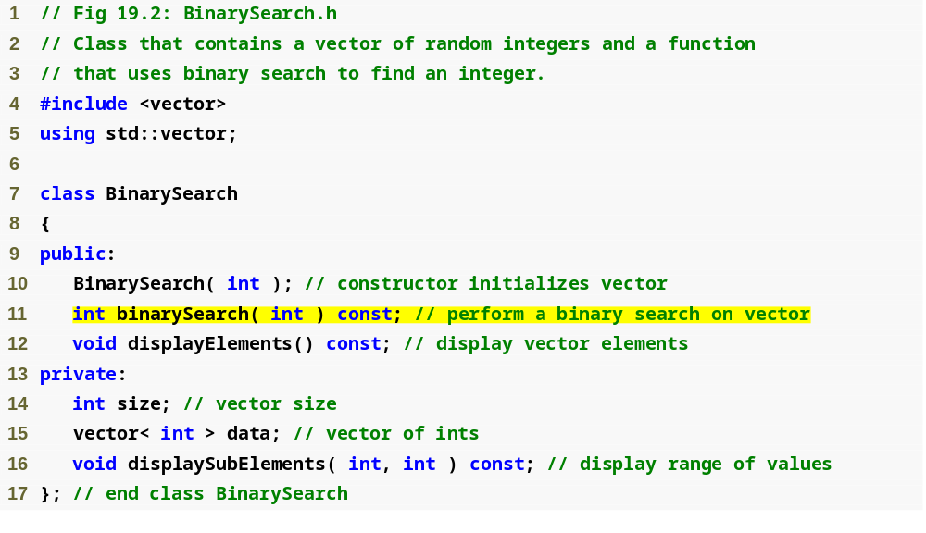
Outline
BinarySearch.h
(1 of 1)

Slide 20
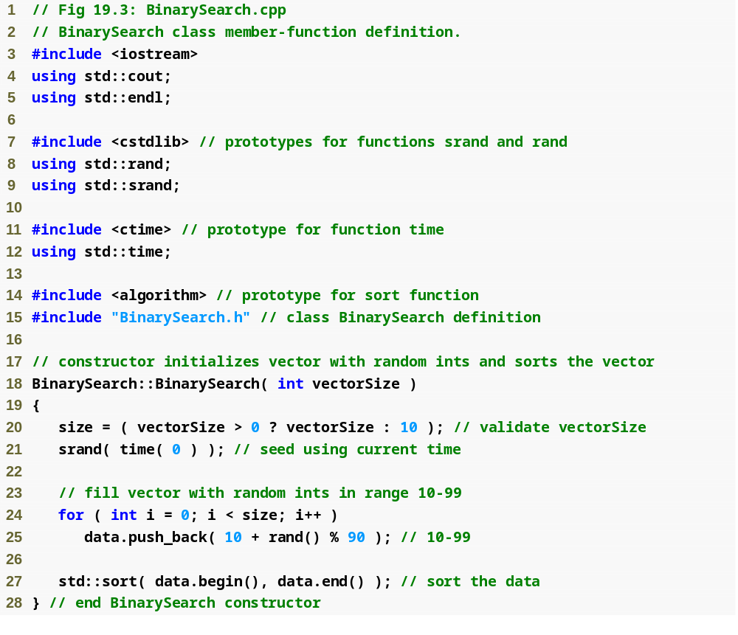
Outline
BinarySearch.cpp
(1 of 3)
Initialize the vector with random ints from 10-99
Sort the elements in vector data in ascending order

Slide 21
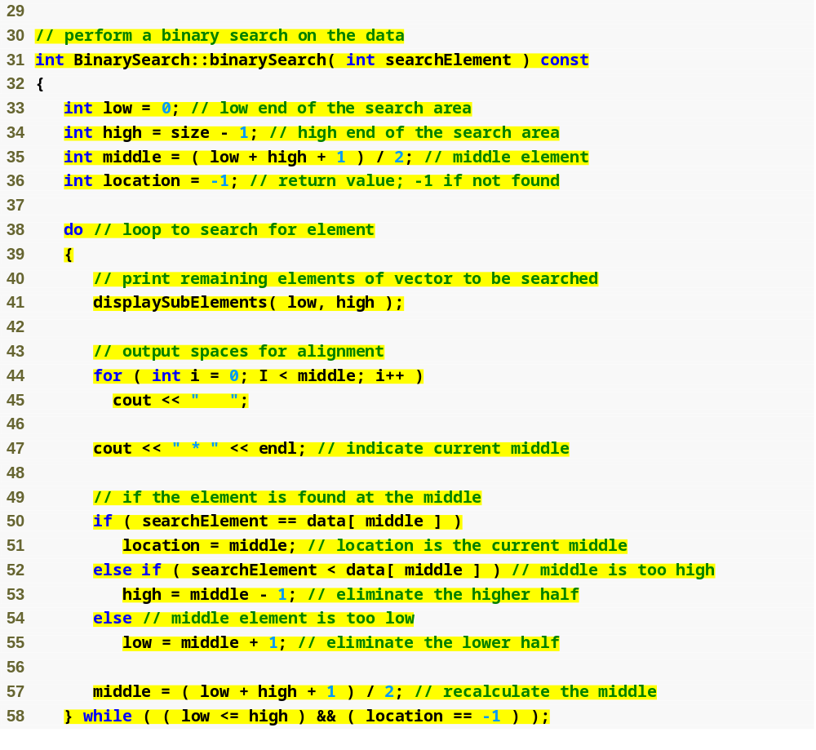
Outline
Calculate the low end index, high end index and middle index of the portion of the vector being searched
BinarySearch.cpp
(2 of 3)
Initialize the location of the found element to -1, indicating that the search key has not (yet) been found
Test if the middle element is equal to searchElement
Eliminate half of the remaining values in the vector
Loop until the subvector is of zero size or the search key is located

Slide 22
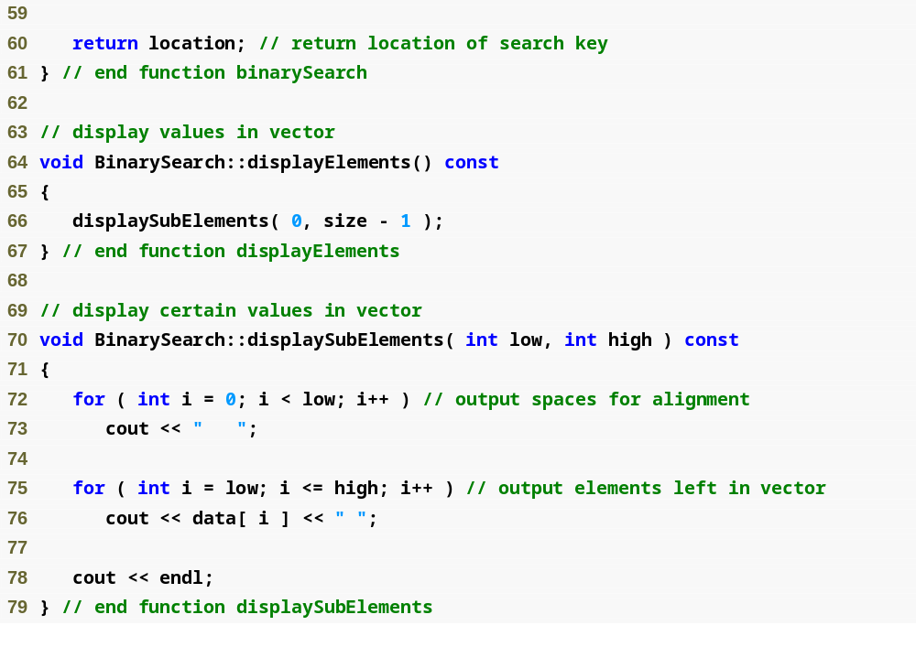
Outline
BinarySearch.cpp
(3 of 3)

Slide 23
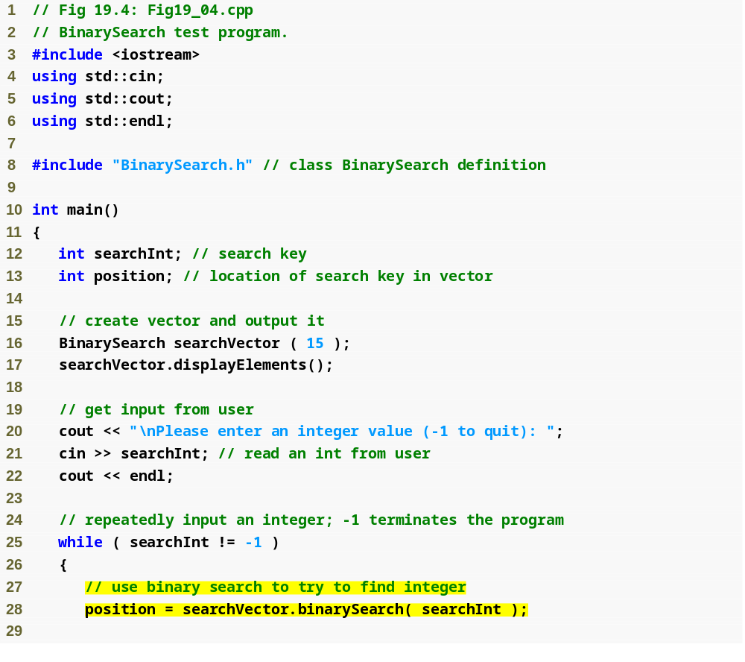
Outline
Fig20_04.cpp
(1 of 3)
Perform a binary search on the data

Slide 24
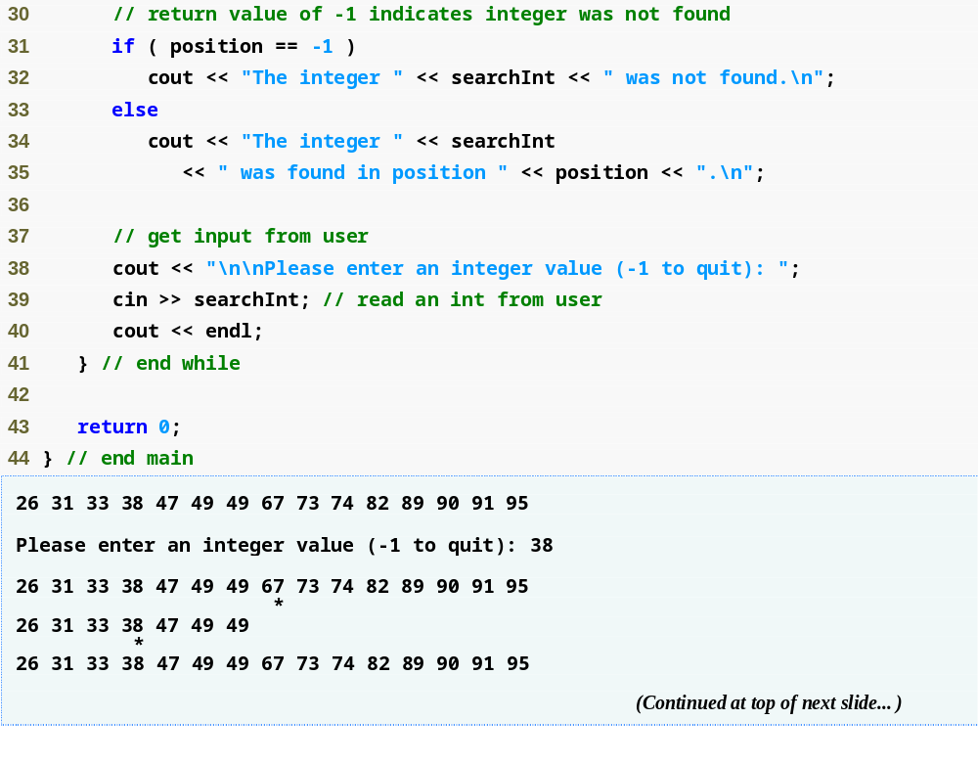
Outline
Fig19_04.cpp
(2 of 3)

Slide 25
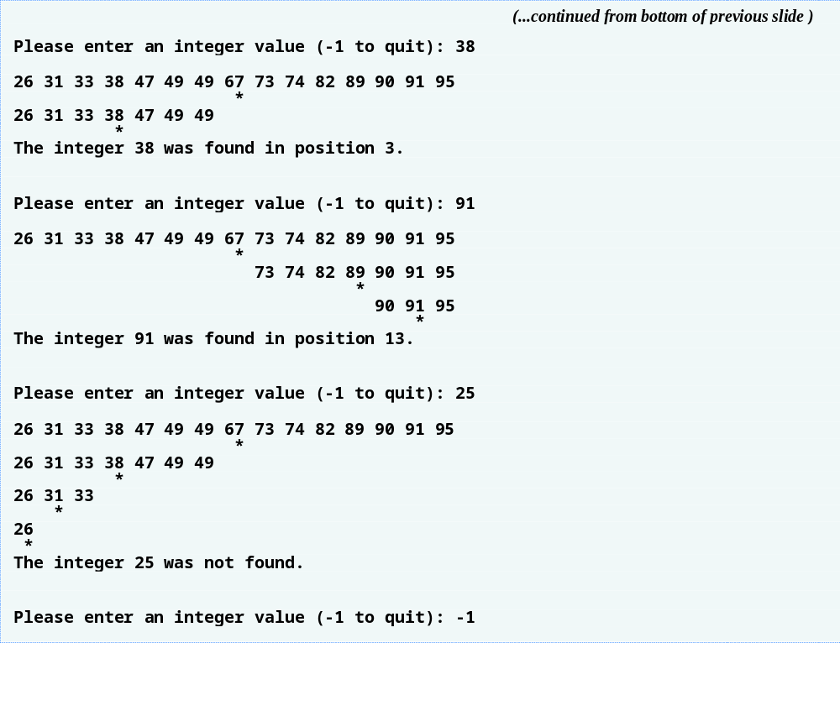
Outline
Fig19_04.cpp
(3 of 3)

Slide 26
19.2.2 Binary Search (Cont.)
Efficiency of binary search
  Logarithmic runtime
    Number of operations performed by algorithm grows logarithmically as number of items increases
    Represented in Big O notation as O(log n)
      Pronounced “on the order of log n” or “order log n”
    Example
      Binary searching a sorted vector of 1023 elements takes at most 10 comparisons ( 10 = log ₂ ( 1023 + 1 ) )
        Repeatedly dividing 1023 by 2 and rounding down results in 0 after 10 iterations

Slide 27
19.3 Sorting Algorithms
Sorting algorithms
  Placing data into some particular order
    Such as ascending or descending
  One of the most important computing applications
  End result, a sorted vector, will be the same no matter which algorithm is used
    Choice of algorithm affects only runtime and memory use

Slide 28
19.3.1 Efficiency of Selection Sort
Selection sort
  At ith iteration
    Swaps the ith smallest element with element i
  After ith iteration
    Smallest i elements are sorted in increasing order in first i positions
  Requires a total of (n² – n)/2 comparisons
    Iterates n - 1 times
      In ith iteration, locating ith smallest element requires n – i comparisons
    Has Big O of O(n²)

Slide 29
19.3.2 Efficiency of Insertion Sort
Insertion sort
  At ith iteration
    Insert (i + 1)th element into correct position with respect to first i elements
  After ith iteration
    First i elements are sorted
  Requires a worst-case of n² inner-loop iterations
    Outer loop iterates n - 1 times
      Inner loop requires n – 1iterations in worst case
    For determining Big O, nested statements mean multiply the number of iterations
    Has Big O of O(n²)

Slide 30
19.3.3 Merge Sort (A Recursive Implementation)
Merge sort
  Sorts vector by
    Splitting it into two equal-size subvectors
      If vector size is odd, one subvector will be one element larger than the other
    Sorting each subvector
    Merging them into one larger, sorted vector
      Repeatedly compare smallest elements in the two subvectors
      The smaller element is removed and placed into the larger, combined vector

Slide 31
19.3.3 Merge Sort (A Recursive Implementation) (Cont.)
Merge sort (Cont.)
  Our recursive implementation
    Base case
      A vector with one element is already sorted
    Recursion step
      Split the vector (of ≥ 2 elements) into two equal halves
        If vector size is odd, one subvector will be one element larger than the other
      Recursively sort each subvector
      Merge them into one larger, sorted vector

Slide 32
19.3.3 Merge Sort (A Recursive Implementation) (Cont.)
Merge sort (Cont.)
  Sample merging step
    Smaller, sorted vectors
      A: 4 10 34 56 77
      B: 5 30 51 52 93
    Compare smallest element in A to smallest element in B
      4 (A) is less than 5 (B)
        4 becomes first element in merged vector
      5 (B) is less than 10 (A)
        5 becomes second element in merged vector
      10 (A) is less than 30 (B)
        10 becomes third element in merged vector
      Etc.

Slide 33
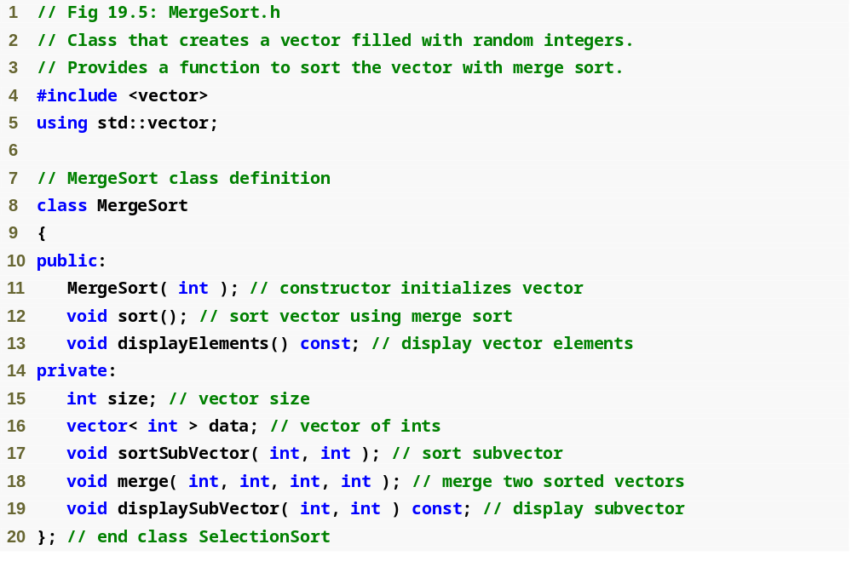
Outline
MergeSort.h
(1 of 1)

Slide 34
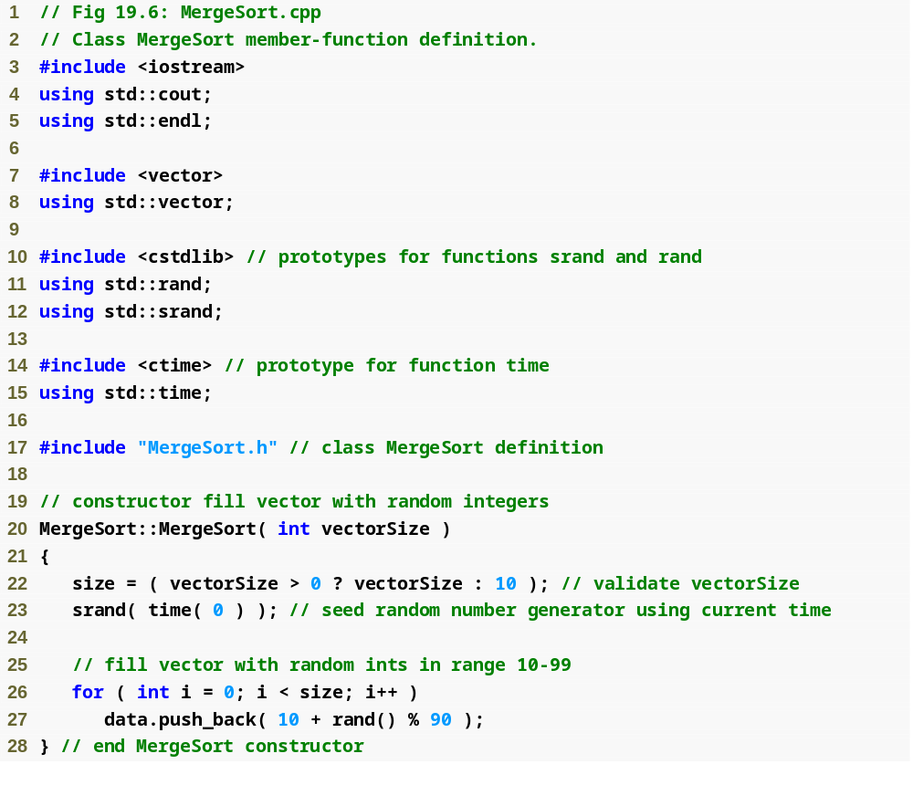
Outline
MergeSort.cpp
(1 of 5)

Slide 35
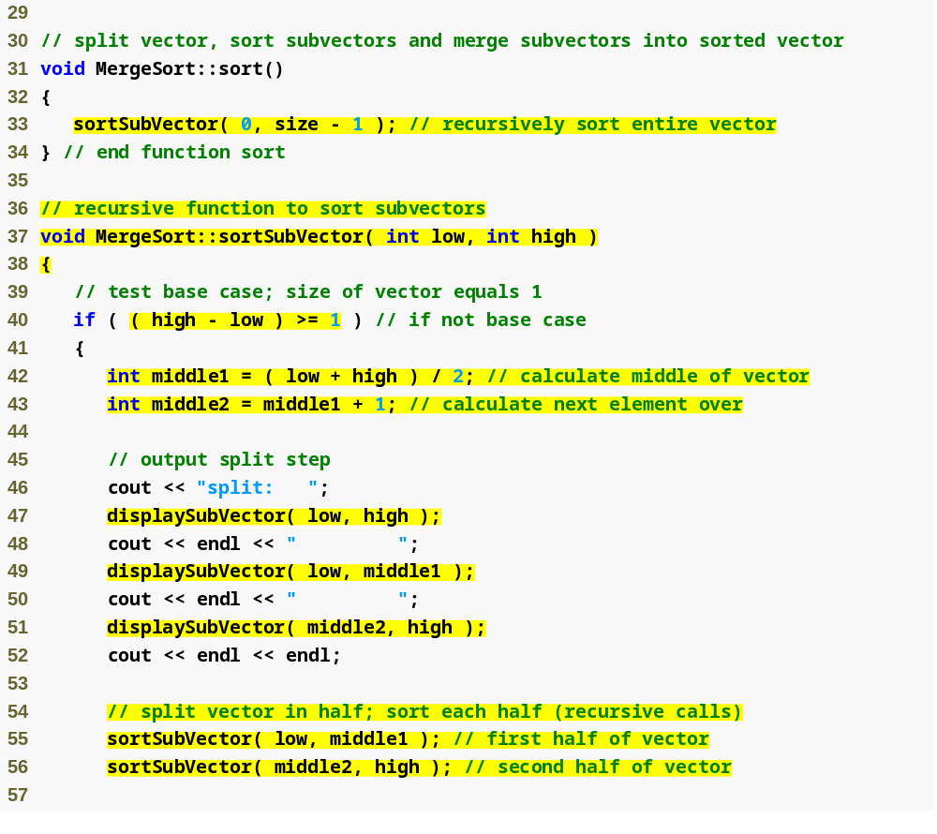
Outline
MergeSort.cpp
(2 of 5)
Call function sortSubVector with 0 and size – 1 as the beginning and ending indices
Test the base case
Split the vector in two
Recursively call function sortSubVector on the two subvectors

Slide 36
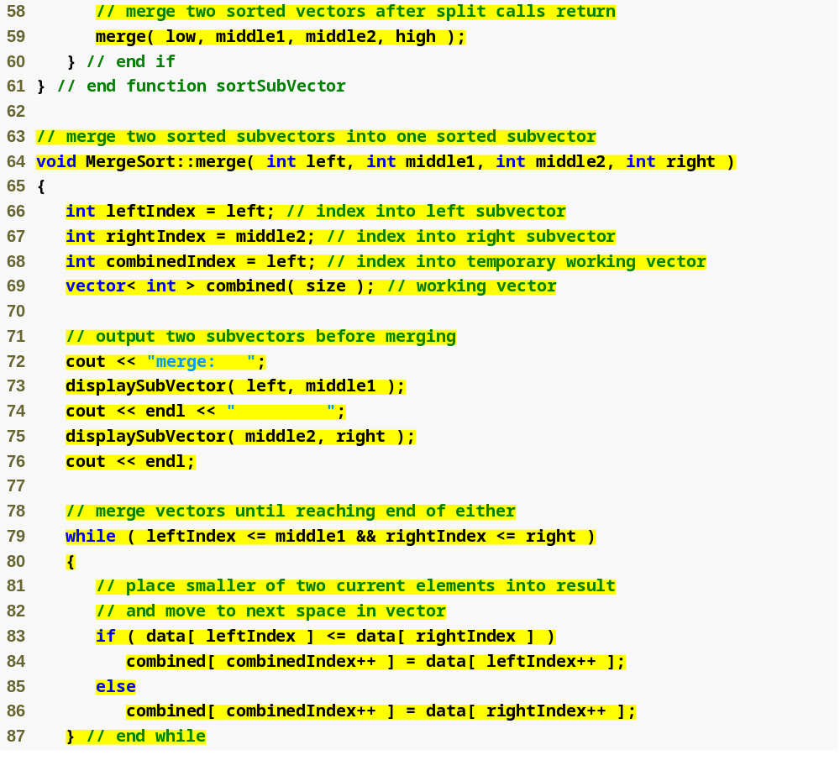
Outline
Combine the two sorted vectors into one larger, sorted vector
MergeSort.cpp
(3 of 5)
Loop until the end of either subvector is reached
Test which element at the beginning of the vectors is smaller
Place the smaller element in the combined vector

Slide 37
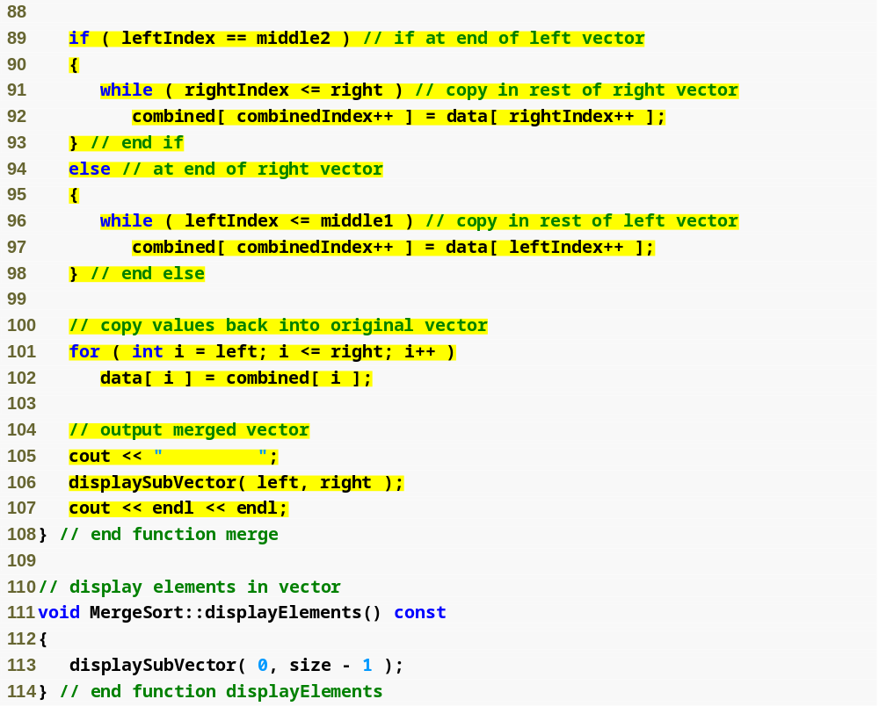
Outline
Fill the combined vector with the remaining elements of the right vector or…
MergeSort.cpp
(4 of 5)
…else fill the combined vector with the remaining elements of the left vector
Copy the combined vector into the original vector

Slide 38
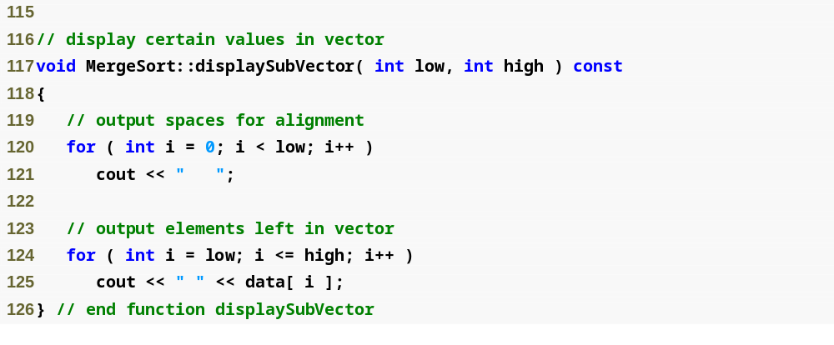
Outline
MergeSort.cpp
(5 of 5)

Slide 39
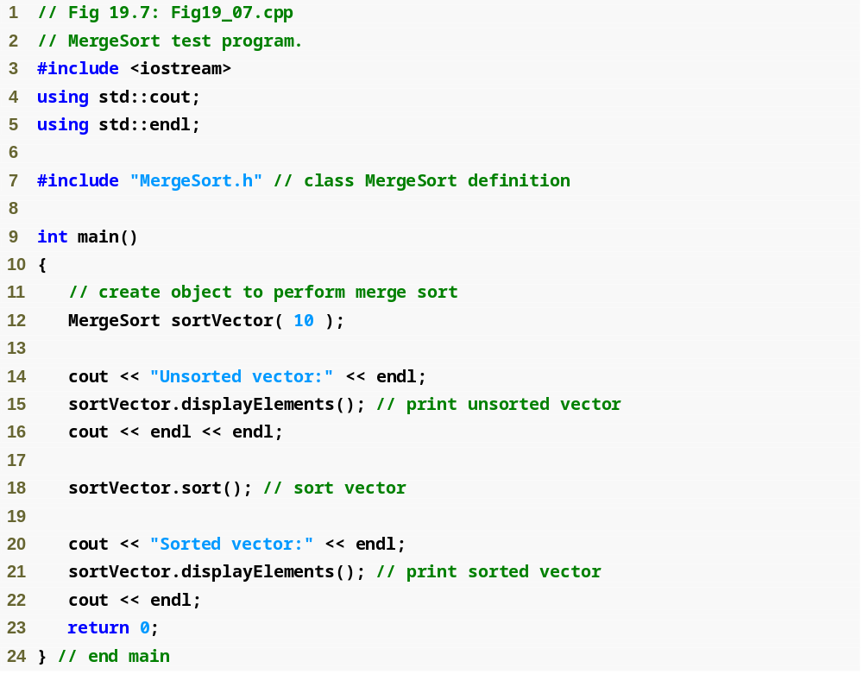
Outline
Fig19_07.cpp
(1 of 3)

Slide 40
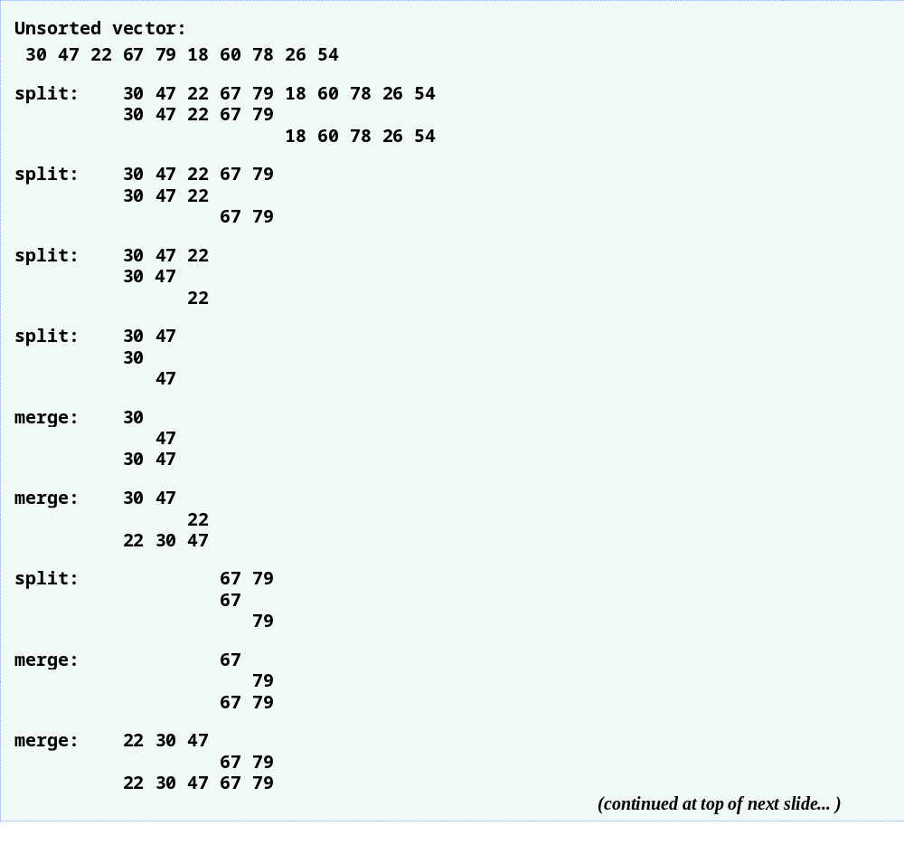
Outline
Fig19_07.cpp
(2 of 3)

Slide 41
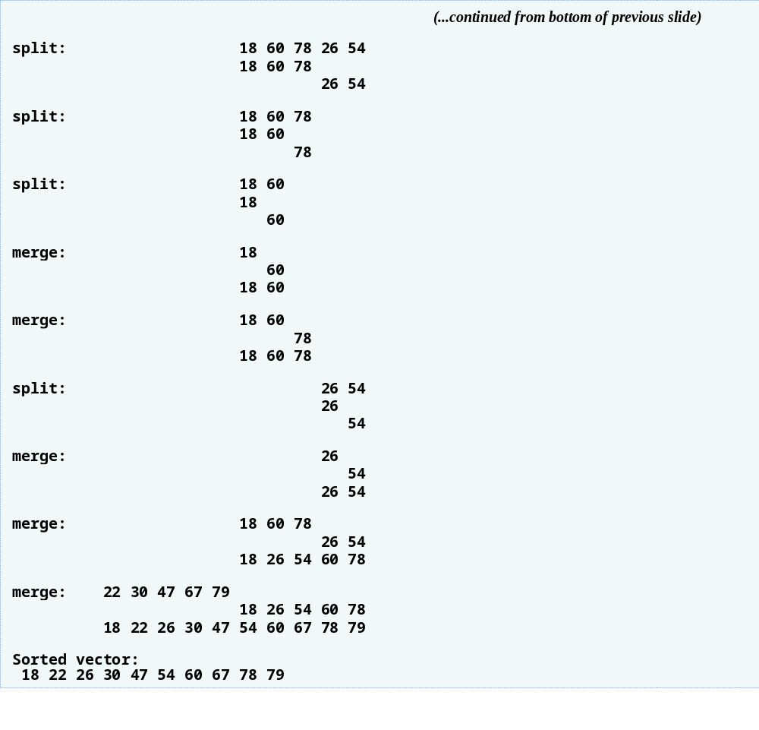
Outline
Fig19_07.cpp
(3 of 3)

Slide 42
19.3.3 Merge Sort (A Recursive Implementation) (Cont.)
Efficiency of merge sort
  n log n runtime
    Halving vectors means log ₂ n levels to reach base case
      Doubling size of vector requires one more level
      Quadrupling size of vector requires two more levels
    O(n) comparisons are required at each level
      Calling sortSubVector with a size-n vector results in
        Two sortSubVector calls with size-n/2 subvectors
        A merge operation with n – 1 (order n) comparisons
      So, always order n total comparisons at each level
    Represented in Big O notation as O(n log n)
      Pronounced “on the order of n log n” or “order n log n”

Slide 43
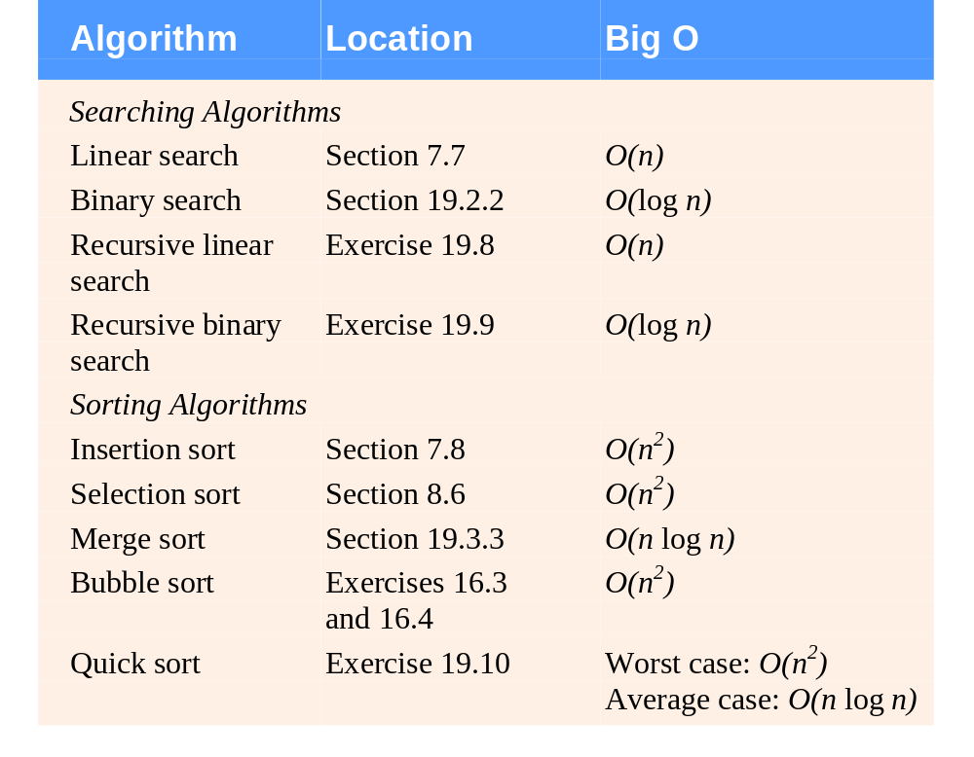
Fig. 19.8 | Searching and sorting algorithms with Big O values.

Slide 44
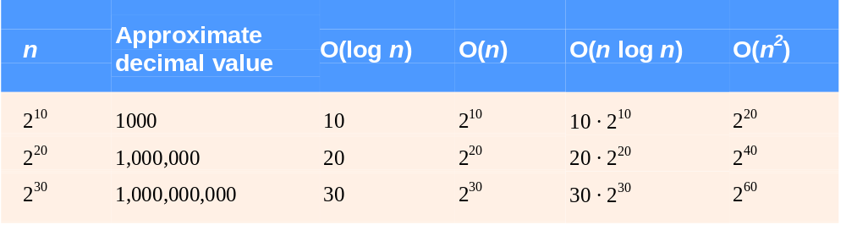
Fig. 19.9 | Approximate number of comparisons for common Big O notations.

